Slide 1
Azure DocumentDB
[ Instructor Name ]
[ Instructor E-mail ]

Slide 2


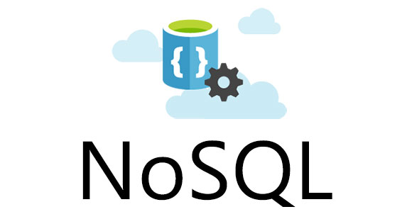
Azure DocumentDB
Azure DocumentDB is a fully managed NoSQL “database as a service” built for ultra-fast and predictable performance, high availability, elastic scaling, and global distribution, and is especially focused on ease of development.
Notes:
Azure DocumentDB is schema-free and combines rich and familiar SQL query capabilities with consistent low latencies on JSON-based data models, targeting solutions for web, mobile, gaming, and IoT. Since DocumentDB is schema agnostic, it makes it extremely easy to adjust and adapt data models on the fly as business logic and application scenarios change. With DocumentDB you no longer have to deploy constant updates to the data-tier and worry about managing schema and relationships. All content in DocumentDB is automatically indexed, which makes it possible to query data across entire structures at any time. The term “NoSQL” is more of a marketing buzzword, and actual means “no requirement for entity relationships and secondary indexing” in order to query information.

Slide 3
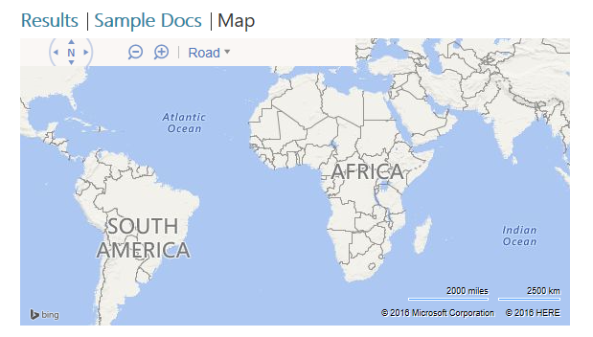
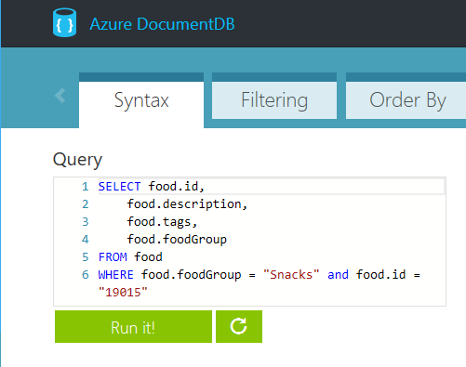
DocumentDB Development
Developing solutions against DocumentDB is designed to be simple and “approachable”, meaning you can start leveraging existing programming skills from the beginning— without needing to learn another proprietary language.
Notes:
Programming against DocumentDB is simple, approachable, and does not require you to adopt new tools or adhere to custom extensions to JSON or JavaScript. You can access all of the database functionality including CRUD, query, and JavaScript processing over a simple RESTful HTTP interface. DocumentDB embraces existing formats, languages, and standards while offering high value database capabilities on top of them.

Slide 4




Supported Languages & Frameworks
Tools, SDKs, and standards-based interfaces are available for DocumentDB development with powerful support for querying against most datatypes, even geospatial.
Node.js
.NET
Python
Java
REST
SQL
Notes:
Since DocumentDB is a JSON-based storage mechanism, accessing and interacting with data can be accomplished through most standards-based interfaces, as well as robust toolsets and SDKs. Although native Universal Windows Platform support is not currently available, support for virtually any other development scenario is available. Deeper level features of are currently exposed via JavaScript, such as stored procedures, triggers and user defined functions (UDFs) making it easy for developers to write application logic that can be packaged and executed directly on database storage partitions.

Slide 5
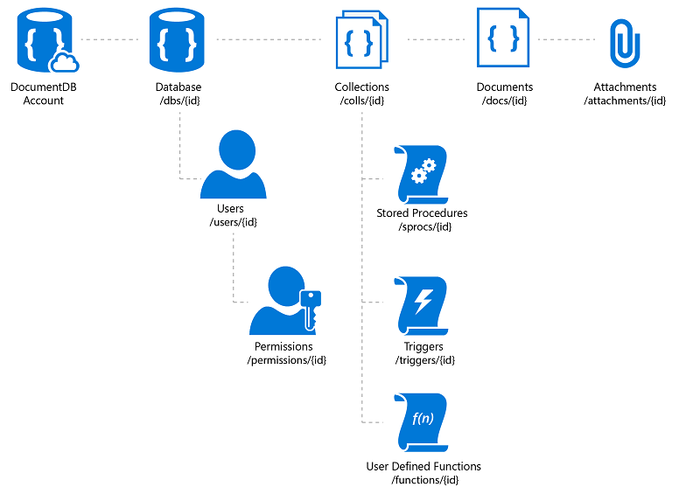
Azure DocumentDB Resources
Database
User
Collection
Stored Procedure
Trigger
User-defined Function (UDF)
Document
Attachment
Notes:
To make sure specific concepts are understood, its helpful to review terminology used by DocumentDB documentation and supporting concepts. Although many of these terms and concepts apply to other data storage technologies, there are often differences in the way these terms apply to Azure DocumentDB in practical scenarios. In Azure DocumentDB systems, all elements of the hierarchy are referred to as “resources”.

Slide 6
Resource Hierarchy
Database
A database is a logical container of document storage partitioned across collections. It is also a users container.
User
The logical namespace for scoping permissions.
Permission
An authorization token associated with a user for access to a specific resource.
Collection
A collection is a container of JSON documents and the associated JavaScript application logic.
Notes:
Most terms used in the context of Azure DocumentDB are similar, or at least conceptual similar to terms used in both object-oriented and relational database strategies, however the scope and design of certain elements differs in exact implementation. For example an Azure DocumentDB “Collection” can span multiple servers and partitions and are the primary entity of DocumentDB “groupings”. The terms “database” and “container” are often used synonymously, as the term database is more conceptual than physical.

Slide 7
Resource Hierarchy
Stored Procedure
Application logic written in JavaScript which is registered with a collection and transactionally executed within the database engine.
Trigger
Application logic written in JavaScript executed before or after either an insert, replace or delete operation.
UDF
Application logic written in JavaScript. UDFs enable you to model a custom query operator and thereby extend the core DocumentDB query language.
Document
Arbitrary user-defined JSON content. By default, no schema needs to be defined nor do secondary indices need to be provided for all the documents added to a collection.
Notes:
Similar to the terms container and database, the DocumentDB term “document” is often confusing to new developers, as “document” more commonly means a “file-based” item, such as a PDF or Word document, Excel spreadsheet, PowerPoint slide deck, or even a text file. The term document in DocumentDB-speak is actually a JSON-based representation of data, and only optionally contains binary data. To get a better picture of what a document “looks like” in DocumentDB terms, imagine a single record from a relational database formatted as a JSON object. Although optional, attachments are also supported to store binary data.

Slide 8

Resource Associations
ACCOUNT
ACCOUNT
ACCOUNT
DATABASE
DATABASE
DATABASE
DATABASE
DATABASE
DATABASE
COLLECTION
COLLECTION
COLLECTION
DOCUMENTS
DOCUMENTS
DOCUMENTS
DOCUMENTS
Notes:
The database entities that DocumentDB manages are referred to as resources. Each resource is uniquely identified by a logical URI. You can interact with the resources using standard HTTP verbs, request/response headers and status codes, as well as object and property-based methods via the tools and SDKs.

Slide 9
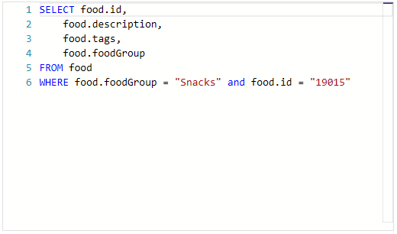
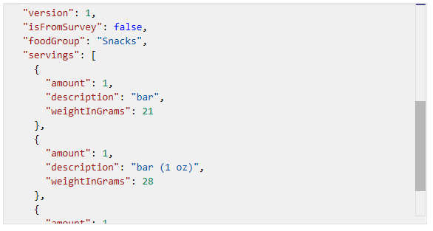
Querying Data
Azure DocumentDB supports querying of documents using a familiar SQL (Structured Query Language) over hierarchical JSON documents.
SELECT, FROM, and WHERE statements
HAVING and ORDER BY statements
Full Geospatial and Geometry support, such as ST_DISTANCE and ST_WITHIN
Notes:
Since DocumentDB is “schema-free” it provides automatic indexing of JSON documents without requiring explicit schema or creation of secondary indexes. If you’re familiar with legacy T-SQL or (Transactional Structured Query Language) commands you’ll be right at home querying DocumentDB content. Querying content typically consists or writing SELECT queries with option WHERE clauses and can be combined and joined across objects in the collection hierarchy.

Slide 10
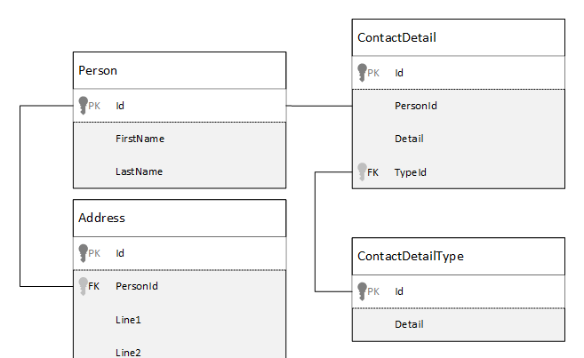
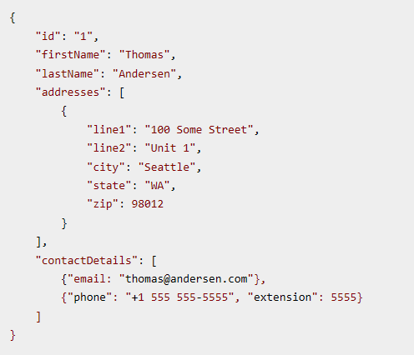
Modeling
Modeling is the technique of creating a logical connections and relationships between data sources.
referenced
Normalizing is referred to as referencing
Denormalizing is referred to as embedding
In some scenarios a hybrid model is acceptable, based on performance
embedded
Notes:
When modeling data stored in DocumentDB document stores entities are always exposed as self-contained documents represented in JSON. Unlike relational database scenarios, DocumentDB best practice concepts maintain that everything gets stored as “denormalized” and content gets embed via queries and modeled queries into a single document.

Slide 11

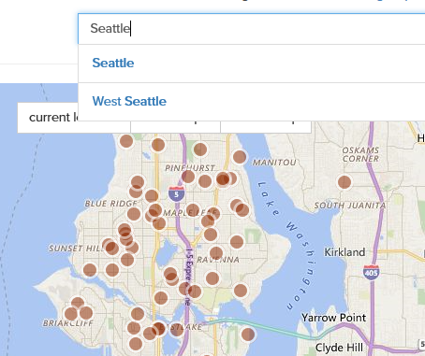
Azure Search
Azure Search is “delegated” cloud-based search service that can be populated and indexed to provide ultra-high performing queries against data sources, including Azure DocumentDB.
Notes:
Azure Search can be integrated into your development ecosystems to add extremely performant search experience to any scenario, including web and mobile applications. Azure Search allows add a these experiences to your applications using a simple REST API or .NET SDK without managing search infrastructure or becoming an expert in search, and supports querying and indexing against all common datatypes and structures, including geospatial and mapping data.

Slide 12
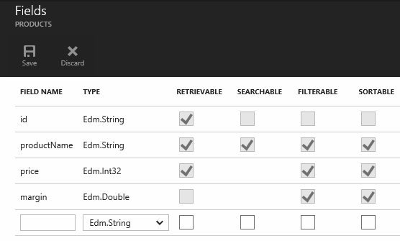
Azure Search Indexing
Ultra-fast performance
Can be managed at a granular level
Supports both rudimentary and extended datatypes
Can be managed programmatically
Notes:
The mechanism used by Azure Search to support ultra-fast querying is based on the concept of creating and managing indexes. An index is a persistent store of documents (and other constructs) identified by the Azure Search service. A document is a single unit of searchable data in your index. In Azure Search terminology, an index is conceptually similar to a table, and documents are roughly equivalent to rows in a table. Azure Search is often combined with support database storage mechanisms, such as SQL Server, Azure Blob Storage, and Azure DocumentDB to provide enhanced search experiences. Just as with Azure DocumentDB scenarios, Azure Search indexes and tuning can be managed via REST-ful HTTP calls or supported SDKs.

Slide 13
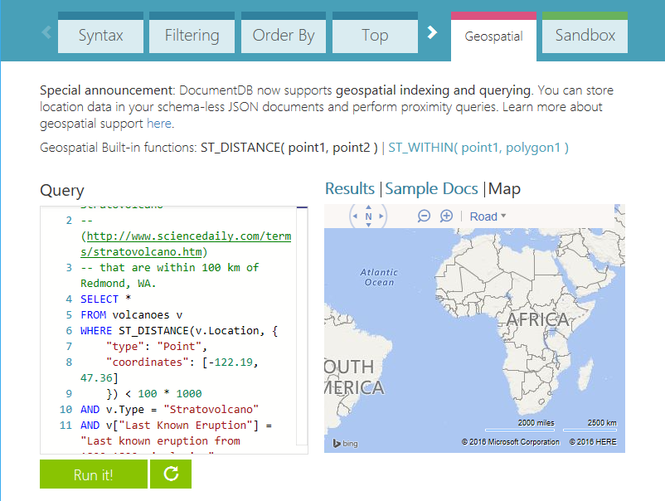
Exploring Data
Before you start working with live data, or restructure and re-modeling your data schemas and relationships, its often helpful to “practice” in a safe environment. The Azure DocumentDB Query Playground has been designed for this purpose and located at: https://www.documentdb.com/sql/demo
Notes:
To get familiar with DocumentDB querying techniques and practice writing and adapting classic SELECT, FROM and WHERE queries into more DocumentDB-centric logic visualizations, the Azure Portal provides a DocumentDB Query Playground where you can experiment with various types of queries and data sources, including de-normalized, unstructured, and geospatial sample data.

Slide 14
Hands-On Lab
Azure DocumentDB.html

